Slide 1



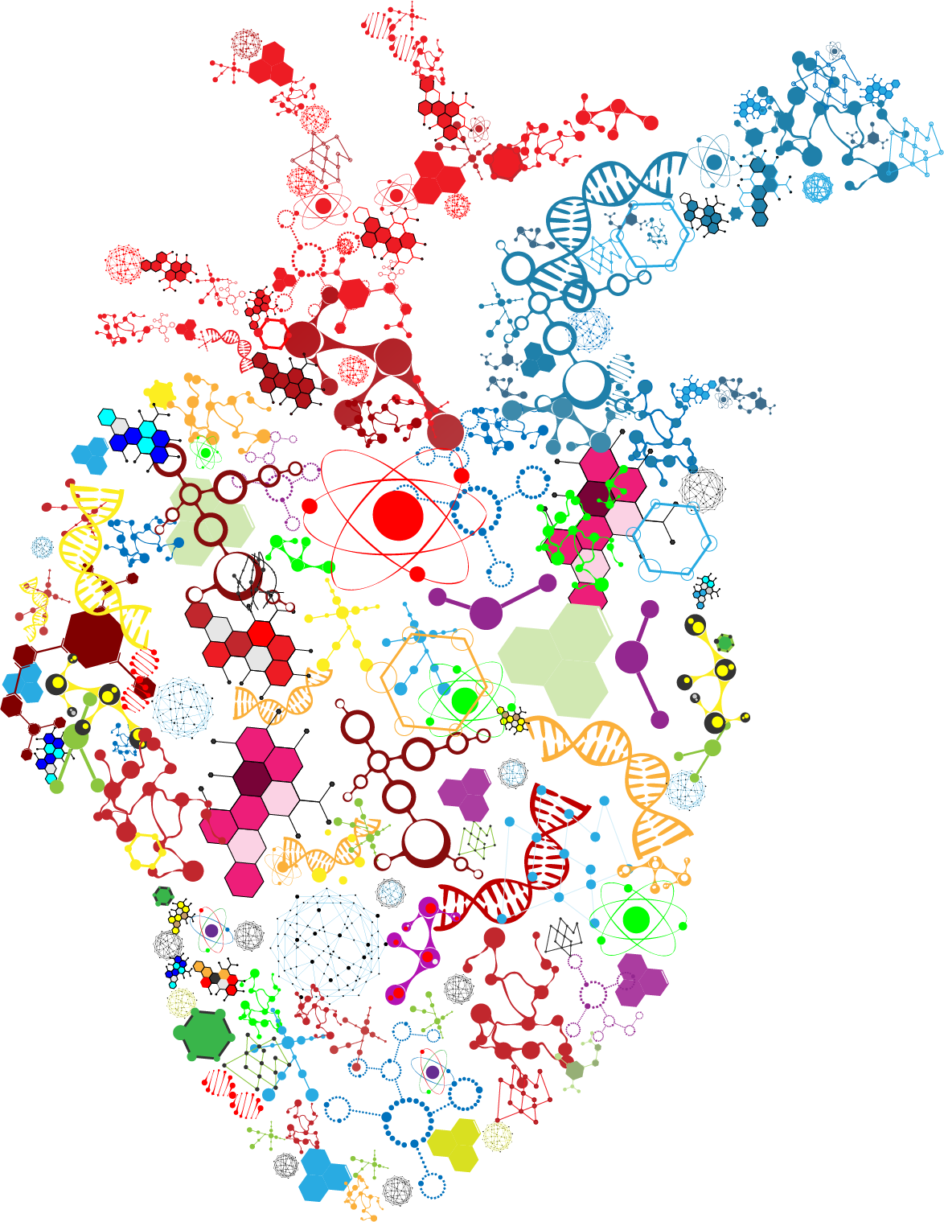


Notes:
Export wide 3680

